Slide 1
Introduction to SDEV1201

Slide 2
Teams How-To
Channels
  Files
Meetings
  Webcam & Mic
  Chat
  Raise Hand / Reactions
  Closed Captions
  Recordings & Transcriptions

Slide 3


Today’s agenda
Introductions
“Housekeeping” & classroom expectations
Student services & resources
Course outline & calendar
Intro to databases

Slide 4
Welcome
Instructor: Larisa Pitchko
MS Teams Chat – Please include your name, SDEV 1701, and your section (e.g., A01) in your message.
Chat with me on MS Teams
Email: larisap@nait.ca

Slide 5
Housekeeping: Attendance
I expect you to attend class.
  Please let me know if you are unable to attend a class. You are responsible for catching up on any missed material.
Punctuality is appreciated.
  But I'd rather you join late than not at all.
Breaks will happen every ~45 min.
  Let me know if you need a break sooner!
Interruptions are disruptive.
  Make sure your devices are set to silent.
  If you need to step out for any reason, please try to do so quietly.

Slide 6
Housekeeping: Communication
Questions are very welcomed!
  During class: raise your hand (or use chat for online classes).
  Outside of class: use Teams DM, Q&A channel, or email.
  If questions are out of scope (or we're short on time) I may add them to the Parking Lot.
I strive to respond to Emails & Teams Messages within 1-2 business days.
  A clear subject line usually means a quicker response.
    e.g. "DMIT 1508 Question on Lab 1" vs "homework"

Slide 7
Housekeeping: In-Person Logistics
Nearest exit
WCs
  Men's: A and B wings
  Women's: B and C wings
  Gender-inclusive: 1st floor (W106)

Slide 8
NAIT Resources
Tutoring & accommodations
Student rights & responsibilities
Counselling
Mental health
Spiritual well-being
International centre
Nîsôhkamâtotân Centre
2SLGBTQIA+ Students
Scholarships
Financial Aid
Job postings
NAITSA events

Slide 9
NAIT Resources
Tutoring & accommodations
Student rights & responsibilities
Counselling
Mental health
Spiritual well-being
International centre
Nîsôhkamâtotân Centre
2SLGBTQIA+ Students
Scholarships
Financial Aid
Job postings
NAITSA events

Slide 10
About the Course

Slide 11
Brightspace Tour
Course Info
  Course Outline
  Syllabus
  Calendar
Resources
  Lesson Slides
  Class Examples
  GitHub page
  Readings & Exercises

Slide 12
Assessments
Most of graded assessments in this course are individual. Any collaboration or duplicate submissions will be granted a score of zero & reported to NAIT.
4 Take-Home Assignment
1 Final Group Presentation
4 Quizzes
  The quizzes in this class are timed. If you require additional time or other accommodations, please contact learningservices.nait.ca.

Slide 13
Assessments
Students are responsible for knowing and adhering to due dates for assessments.
In this course, generative AI is not permitted for assessments, as they are intended to measure your ability to generate your own work. Using prohibited resources will be considered academic misconduct and be addressed following SR 1.3 Academic Integrity Procedure.

Slide 14
Assignment Extension Policy
Students with accommodations are responsible for disclosing those requirements at least 10 days in advance of any extension request.
In the case of extensions requested due to extenuating circumstances (e.g. medical emergency), notify your instructor as soon as possible, 10 days in advance where possible.
  Documentation is generally required to support the request.
  The request should be made in writing and sent via email.
For requests due to religious observances, students must submit a Deferred Exam Request Form at least 10 business days prior.

Slide 15
About you
Share as much as is comfortable!
e.g.
How you're comfy being addressed
Your hometown
Hobbies, interests, favourite sports or movies, etc
If you have kids or pets

Slide 16
About you
Share as much as is comfortable!
e.g.
How you're comfy being addressed
Your hometown
Hobbies, interests, favourite sports or movies, etc
If you have kids or pets

Slide 17
What is a database?
Notes:
What is a Database? — Speaking Notes
“Before we get into all the technical terminology, let's start with a very simple question: What is a database?”
“When you hear the word database, you might immediately think of something complicated — servers, SQL, tables, code. But at its most basic level, a database is simply an organized collection of data.”
“The important word here is organized. We don't just want to have a huge pile of information. We want that information stored in a way that allows us to find it, update it, manage it, and use it.”
familiar example
“Let's say I have a list of 10,000 customers.”
“For each customer, I might have their customer number, first name, last name, address, phone number, email, and maybe their order history.”
“That information is data. If I organize and store it so that I can efficiently work with it, I have a database.”

Slide 18
Why databases?
Notes:
Why Do We Need Databases?
This is where I would slow down a little and make it practical.
“But here's the more interesting question: Why do we need databases in the first place?”
“If I only have five customers, I could probably keep their information in a spreadsheet. I could even write it down on paper.”
“But what happens when I have 5,000 customers? Or 5 million?”
“Now I have a problem.”
Problem 1 — Finding information
“Imagine a company has 100,000 customers and someone asks, ‘Show me every customer who placed an order in the last 30 days.’”
“You don't want an employee manually searching through thousands of records.”
“A database allows us to find specific information quickly.”
Problem 2 — Updating information
“Now imagine a customer moves and changes their address.”
“We don't want their old address sitting in five different places and someone having to remember to update all five.”
“A well-designed database helps us store information in a structured way and update it consistently.”

Slide 19
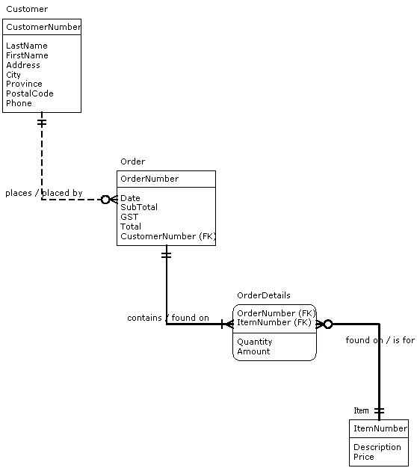
Sample ERD
Notes:
Problem 3 — Relationships between information
“And here's where databases become really useful.”
“Customers don't exist in isolation. Customers place orders. Orders contain products. Products have prices and descriptions.”
Point to the ERD:
“So instead of putting absolutely everything into one giant table, we can organize our information into related entities.”
“Here we have a Customer, an Order, and an Item. The database keeps track of how those pieces of information relate to one another.”
“That's where the word relational comes from. We're not just storing data — we're storing the relationships between pieces of data.”

Slide 20
The Relational DBMS
Customer Number | Last Name | First Name | Address | Phone
100 | Adams | Joan | 9825-77 Ave Edmonton Alberta T5C 8E2 | 780-488-8712
200 | Smith | Miles | 4308-133 Ave Edmonton Alberta T5C 8E9 | 780-438-9523
Notes:
“This is a very simple example of what data might look like inside a relational database. We have rows representing individual customers, and columns representing the different pieces of information we store about them.”

Slide 21
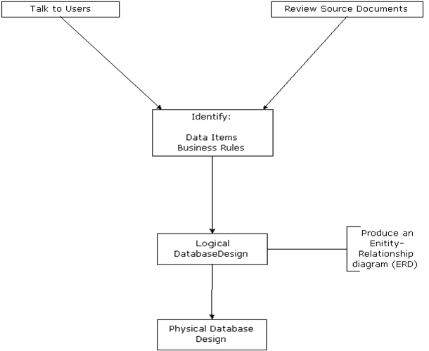
The Database Design Process
Notes:
A Good Real-World Example
I would use something students immediately understand:
“Think about something like Amazon.”
“Amazon needs to know who you are, what you've ordered, what products exist, how much they cost, what is currently in stock, where your order is going, and what you've paid.”
“When you click ‘My Orders,’ Amazon isn't searching through someone's spreadsheet.”
“It's querying a database.”
“When you search for a product, you're querying a database.”
“When you add something to your cart, information is being stored or updated in a database.”
“When you check whether something is in stock — database.”
“When you receive a personalized recommendation — very likely databases are involved there too.”
Then:
“So databases aren't some isolated technology that only database administrators care about. They're underneath a huge portion of the software and services we use every day.”

Slide 22
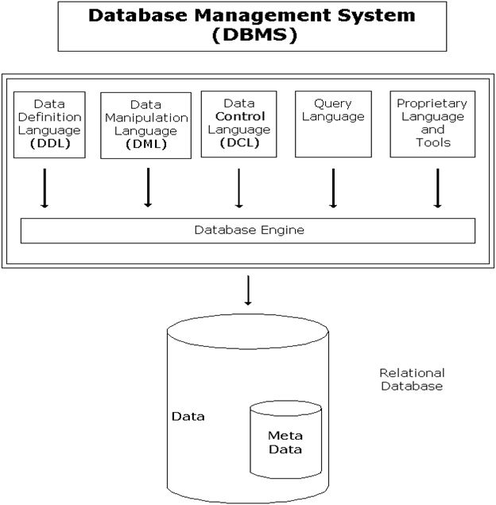
Notes:
Transition to DBMS
Now you can move naturally to the first diagram:
“But there's an important distinction we need to make.”
“A database is where the data is stored.”
“A DBMS, or Database Management System, is the software that allows us to create, manage, access, and work with that data.”
“Think of the database as the organized collection of information, and the DBMS as the system that lets us interact with it.”
You can give them a simple analogy:
“If the database is the library's collection of books, the DBMS is the system that lets you catalog the books, search for a book, check it out, update information, and manage who has access to it.”
“And that's what we're going to be learning how to work with in this course.”

Slide 23
Terminology so far
Database
DBMS (Database Management System)
Business rules (“requirements”)
Entities
Relationships
Entity-relationship model (or data model)
Normalization
Notes:
“You're going to hear quite a few new terms in this course. Don't worry about memorizing all of them today.”
“For now, I want you to recognize these words because we're going to keep coming back to them.”
Then very briefly:
Database — organized collection of data.
DBMS — software used to manage the database.
Business rules — rules describing how the organization operates and what the data needs to represent.
Entities — things we need to keep information about, such as customers, orders, or products.
Relationships — how those entities are connected.
Entity-relationship model — a way of visually representing those entities and relationships.
Normalization — organizing data to reduce unnecessary duplication and improve consistency.
Then:
“We're going to build these concepts one at a time. By the end, you'll be able to look at a real-world situation, figure out what information needs to be stored, determine how that information relates, and turn it into a database design.”

Slide 24
“What are some databases you interacted with today without necessarily realizing it?”
Notes:
Likely answers:
Instagram
TikTok
banking
Amazon
Netflix
Google
school registration
healthcare
Uber
Spotify
email
Almost every one of those systems needs to store and retrieve information about users, transactions, content, or activity.
“The interesting part of databases isn't just storing data. It's figuring out how to organize information so that a computer — and the people using it — can actually make sense of it.”

